Slide 1
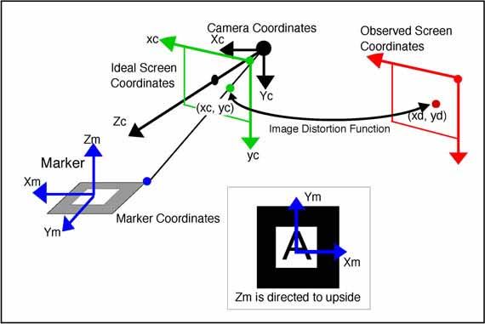
ARToolkit coordinate systems

